Slide 1
Digital Security Services
Service Offerings

Slide 2


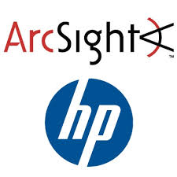
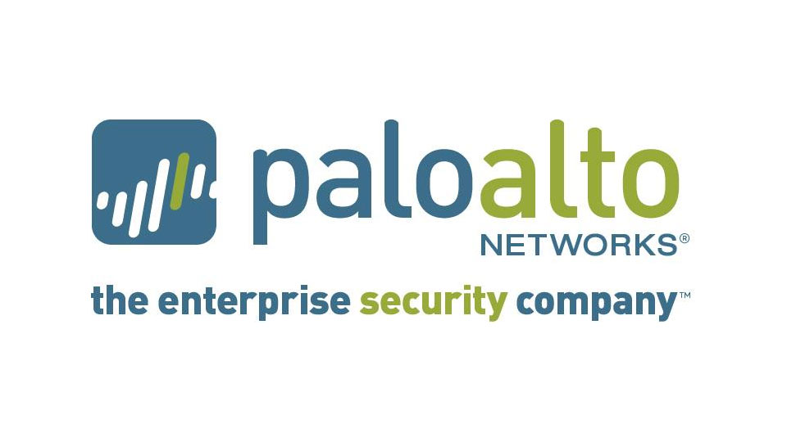

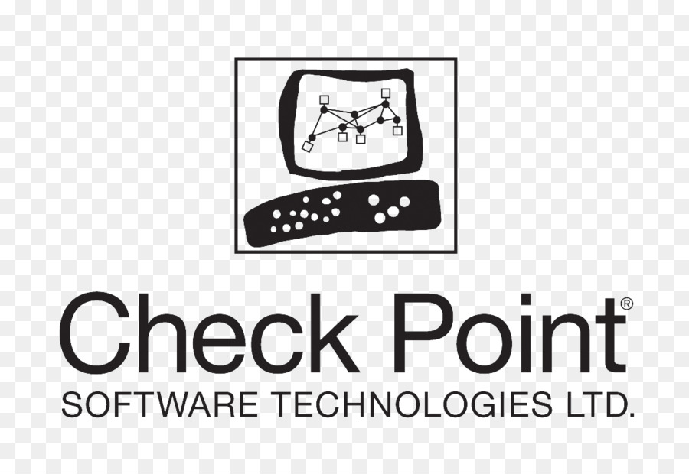


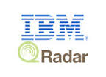


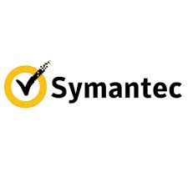
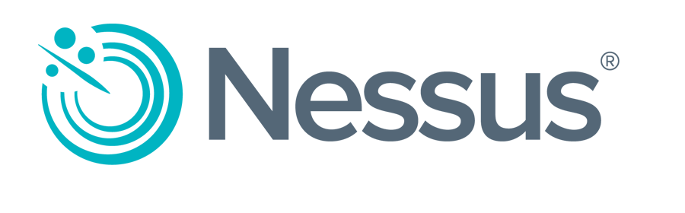



Digital Security Services - Summary
Service Offerings
Skills
A team size of 500+ with more than 100+ Minds certified in industry leading standards
Digital Identity & Access Management Servicees
Cyber Threat Management & Operations
Application Security & Vulnerability Management Services
Governance Risk & Compliance Services
Cloud Security Services
ENABLERS
COE¹ and Technical Advisory
Project Management and Governance
Active Projects
59 across multiple security disciplines
Technologies Supported
Cyber Security Platforms
Foot Note - 1. SOC – Security Operations Center , 2.COE – Center of Excellence,

Slide 3

Digital Security Services Offerings
Identity and Access Management
Threat Management & Operations
Application Security & Vulnerability Management
Governance Risk & Compliance
Cloud Security Services
Identify, Access, Privileges
Detect , Analyze Respond
Zero Trust
Industry Standard Frameworks
Multi Cloud
Build, Engineering and Managed services for:
Identity & Access Management
Privilege Access Management
SSO & MFA
API & Federation
Identity Governance
24x7 NexGen Security Operations
Security Orchestration ,Automation & Response
User Entity and Behavior Analysis
Threat Hunting
Security assessment
DevSecOps integration
API Security
Vulnerability management
Penetration testing
Remediation services
Security risk management
Technical security standards
Policy management ISMS)
Data Governance & Protection
Compliance assessments & Frameworks
Cloud Compute Configuration Hardening
Cloud Security Posture Assessment
Zero Day Attack prevention solutions
Container Security
API Security

Slide 4



Digital Identity & Access Management services
Identity
Access
Privilege
User Lifecycle
web Security
Service Account Management
Certification
Roles Management
MFA
Vaulting
API
Discovery
Analytics
Self Service
Mobile
Cloud federation
Password Rotation
Recording
Risk Management
Consumer/ partner Access
Session Management

Slide 5






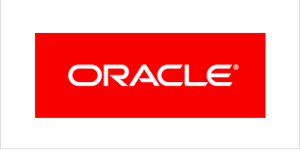


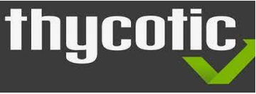



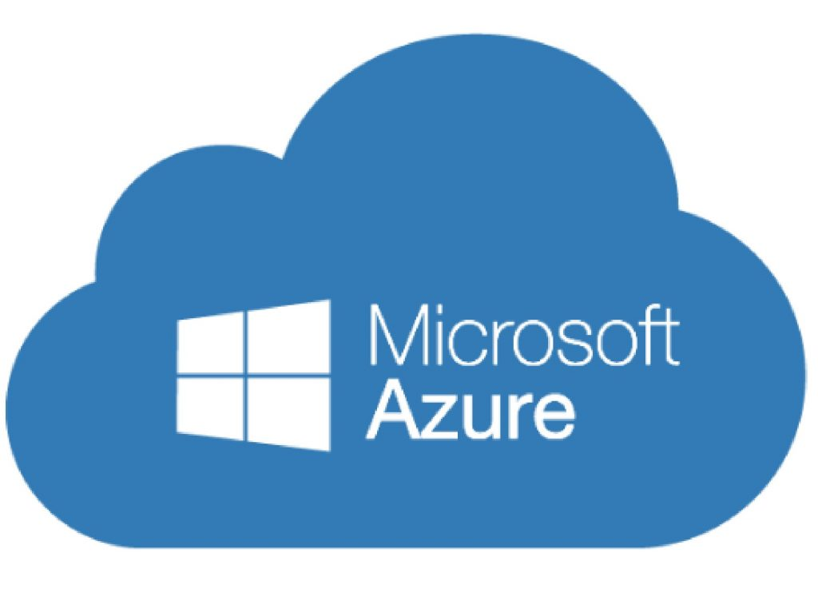


Digital Identity & Access Management –Key Technologies supported
Identity Management
Access Management
Privilege Management
Directory Services/LDAP
0+
IAM Engagements- Implementation & Operations
0 +
IAM technology - Certified Engineers
0 +
Accelerators & Dashboards
5

Slide 6


Cyber Threat Management and Operations – MSOC
*
Services / Capability
Offering
Delivery Model
Managed Detection & Response
Threat Detection
Shared
NextGen Security Operations
Security Orchestration and
Automated Response
Threat Intelligence
User & Entity Behavior Analytics
Threat Hunting
Dedicated
Microsoft Azure Sentinel
24x7x365 Operations

Slide 7
MSOC – Solution Models
Enable
NextGen SOC
Integrate
NextGen SOC
Manage
Customer SIEM
Enable client with SIEM Platform & Services
Hybrid approach to Integrate Client Azure Sentinel Workspace(s) to Managed SOC
Manage & Operate
Client’s Onprem or Cloud SIEM Platform
Outsourced
Co-sourced – Shared Responsibility
Azure Sentinel
Other SIEM
24x7x365 Operations & Management
Seamless and simplified security
Easier management and integration
Leverage AI/ML, intel and automation
Security by design powered by ML at scale
Fewer vendors/products to manage
Modular Capability & Flexible Pricing
We pay for the subscription and invoices the customer
Customer with an EA (Enterprise agreement) may prefer using the EA contract
7

Slide 8
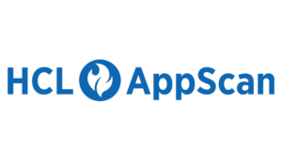
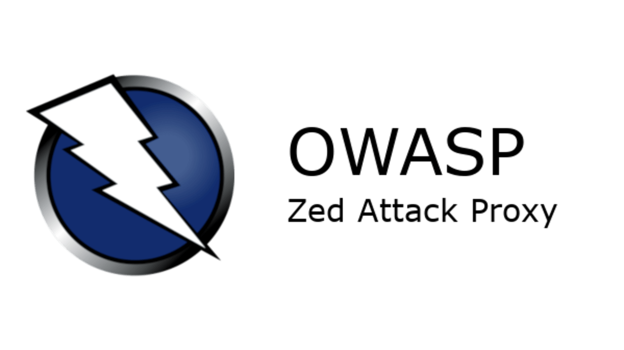
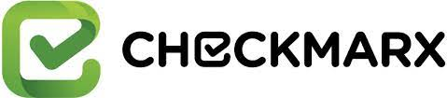
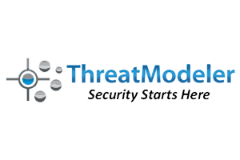
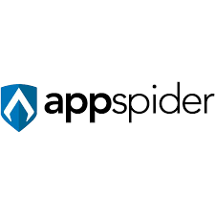
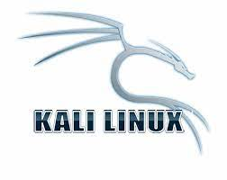

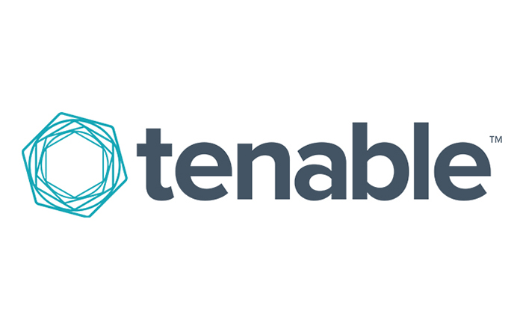
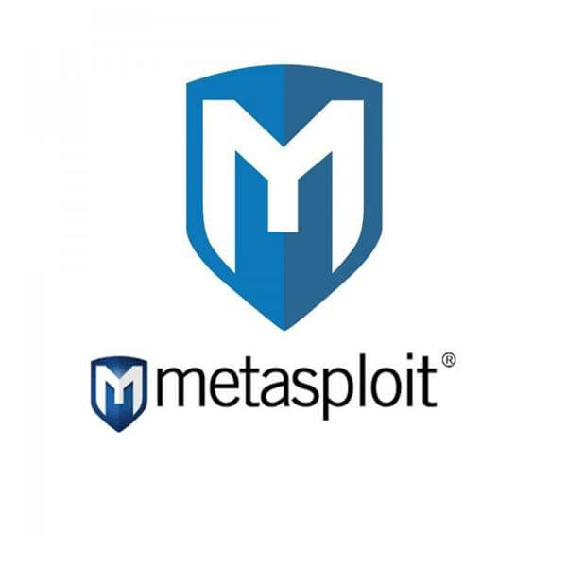

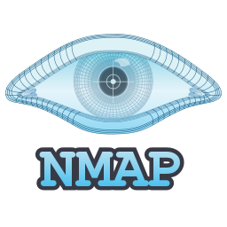


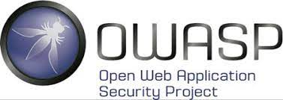
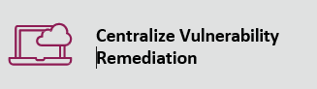
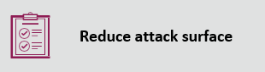
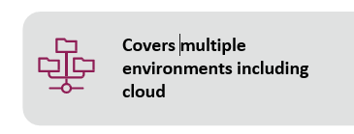
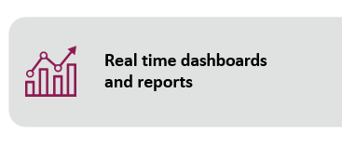
Application Security & Vulnerability Management Services
Tools & Technologies
Application Security
Vulnerability Management Services
Advisory Services
Static Application Security Testing (SAST)
Dynamic Application Security Testing (DAST)
Infrastructure Vulnerability Scanning
Application Vulnerability Scanning
Application security Reviews
Risk Assessment
Threat Modelling
Penetration Testing
Penetration Testing
Remediation Advisory services
Remediation Analysis & advisory
Compliance Assessments
Mobile Application Security Testing
Web Application Security Testing
Vulnerability Program Management
Secure Configuration Assessment
DevSecOps
Data Leakage Prevention
API Security testing
Red teaming Services
Threat & Vulnerability Management Platform

Slide 9





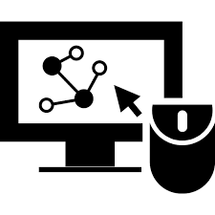


Threat & Vulnerability Management Platform
Single portal Assessment
Leverage Automation
and Orchestration
capabilities
Work any
vulnerability,
once
Streamline
vulnerability
remediation
for whole organization
Platform provide the single umbrella to plan the various scan plan
Assess the Infrastructure Application, Code Scan
Scale to any existing remediation process and migrate to a highly automated process.
Track and analyze previous attacks and vulnerability details utilizing inbuilt data base for comprehensice solutions.
Standardize remediation with one consistent process across the organization
Centralize
Vulnerability
Remediation
Tool integration
Eliminate
Duplicates
Real time
dashboards
and reports
Infrastructure, Application, Code Scan tool Integration
Integrate existing Scan tool Seanlessly
Use existing ticketing tool for managing remediation
Centralized, 360-degree real-time vulnerability management dashboards and reports.
Centralize vulnerability
scan logs from Network,
AppSec and VA/PT solutions
into one centralized console.
Automatically eliminate recurring vulnerabilities
9
Cyber Protection | Cyber Defense | Cyber Consulting| IAM

Slide 10
Governance, Risk and Compliance Services
Information Security Governance Services
ISO 27001 Implementation
Risk Management
Compliance Management
CISO Advisory
Security Metrics
IT Risk assessments
Supplier / Third party risk assessments
Cyber resiliency assessments
Financial Industry Specific assessments (FFIEC, NYDFS, PCI )
Healthcare specific assessments (HIPAA, HITRUST)
GDPR, Privacy assessments
GRC Automation
BC / DR Management
Policies, Standards, Guideline definition
Enterprise Risk assessments
CyberSecurity Controls assessment (NIST, CIS)
RSA Archer Solution design and engineering
BC / DR Program management
Service now GRC Platform engineering and Support
IT General Controls Assessment

Slide 11








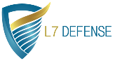

Cloud Security Services Offering
overall_0_132285769990631624 columns_5_132288121945908832 38_1_132285771088076091 56_1_132285771994537079 60_1_132285772020034433 8_1_132288121427966429 11_1_132288121756053773 21_1_132288121778711791 24_1_132288121820163050 31_1_132288121840866144 34_1_132288121845946234 18_1_132288147470866033
Cloud Security Advisory Services

Multi Cloud and Hybrid Security Analysis
Security Assessment of IaaS , PaaS , SaaS, CaaS
Compliance Assessment
Application and Data Protection
Cloud Threat Detection and Response

Vulnerability and Pen Test
Multicloud Threat Management Service
SOC as a Service .Security Analytics (Security Data Lake), UEBA, and Threat Hunting
Cloud Security Services


Identity & Access Management
Multicloud IDAM Modernization
Identity Lifecycle Management
Digital Security

Cloud Security Testing Service
Cloud Data Protection and GRC Services

DAST,SAST and IAST Service
DevSecOPS Roadmap and implementation
Multicloud Security Posture Compliance and Regulatory Assessment and Implementation
Data Risk assessment, Classification and Cyber Protection
Partner

Slide 12
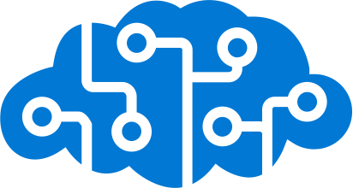
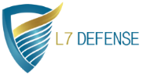
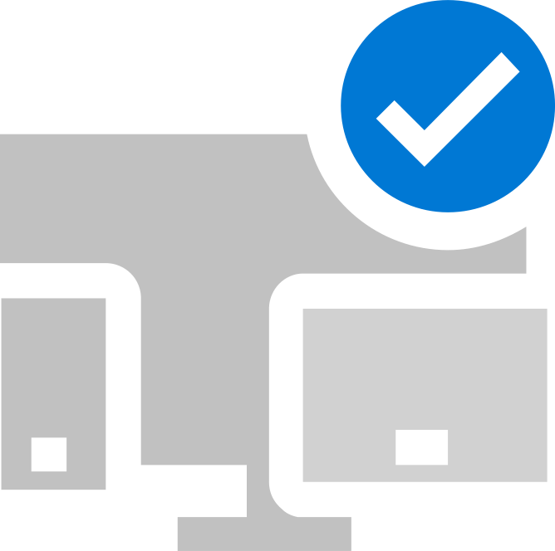


Digital Security Services – Solution Accelerators
Designed & Offered through Microsoft Azure Marketplace
Automated Cloud Security Posture Assessment
API Security
Microsoft Azure Sentinel
Threat Detection & Management Platform
Automated Cloud Compute Configuration Hardening
Securing Linux Workload from Zero Day Attack & Container Security
Securing Web Workload
(PHP , .NET , Java, JavaScript) from Zero Day Attack

